Slide 2
Change Management & implementation of creative solutions
Ahad Rabbani Doost

Slide 3
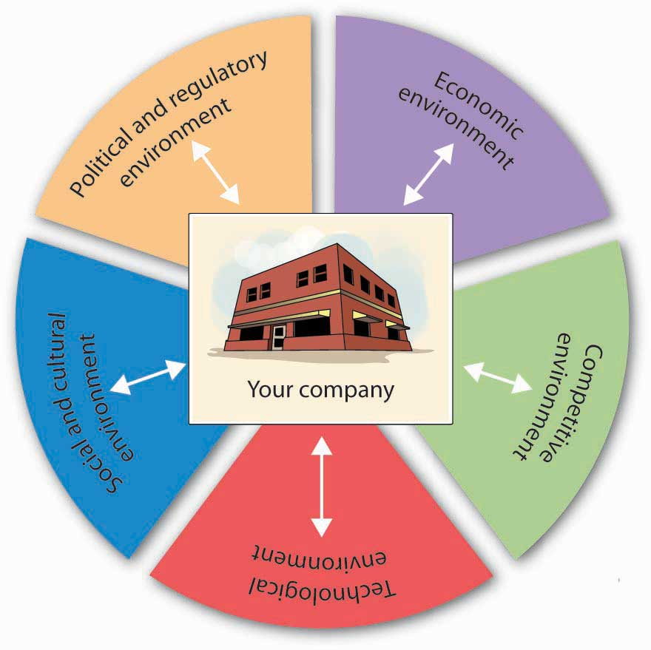
The importance of the changing global business environment.

Slide 4
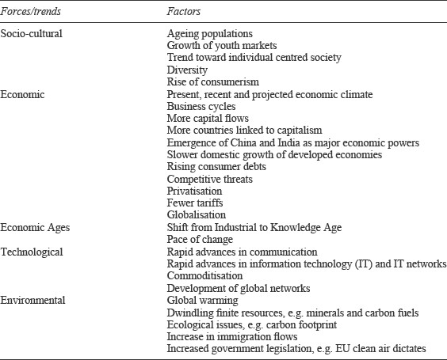
The Factors that cause Change and the Major types of Change.

Slide 5
The world is experiencing several megatrends that may impact our business
The Internet of Things
Artificial Intelligence (AI) and Robotics
Circular Economy
Global warming
Resource scarcity
Big data
Digital platforms

Slide 6
Industry 4.0
The Fourth Industrial Revolution or Industry 4.0, conceptualizes rapid change to technology, industries, and societal patterns and processes in the 21st century due to increasing interconnectivity and smart automation.
Industry 4.0 is the digital transformation of manufacturing or production and related industries and value creation processes.

Slide 7
Circular Economy
Eliminating problematic or unnecessary plastics
Reusing of Plastics
Recycling or Plastics at the end-of-use

Slide 8
Climate protection
Precautionary actions, procedures or installations undertaken to prevent or reduce harm from pollution to natural weather conditions or patterns, including the prevailing temperature, atmospheric composition and precipitation

Slide 10
Innovation in Business
In business, Creativity is Innovation
What is Innovation?
Why innovate?

Slide 11
Common Challenges in the Polymer Industry
Rapid technological advancements
Regulatory changes and compliance requirements

Slide 12
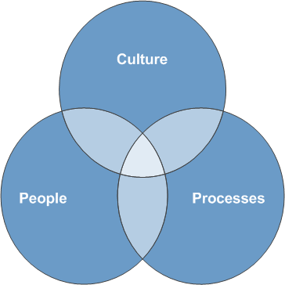
Change
Change usually involves three aspects: people, processes and culture
https://www.jisc.ac.uk/full-guide/change-management

Slide 13
Planning Change
Is all change planned?
What is the difference between planned and emergent change?

Slide 14
Types of Change
Developmental
Transitional
Transformational

Slide 15
Episodic versus Continuous Change
Episodic change - infrequent, discontinuous and intentional change
Continuous change - ongoing, evolving and cumulative change

Slide 16
Why Change Fails
How to Make Change Fail: A Management View
Palmer, I. (2021). Managing Organizational Change: A Multiple Perspectives Approach (4th ed.). McGraw-Hill Higher Education (US). https://bookshelf.vitalsource.com/books/9781264071579

Slide 17
Leaders of Change
Senior Managers
The Chief Transformation Officer
Middle Managers

Slide 18
Change Management Competencies
Palmer, I. (2021). Managing Organizational Change: A Multiple Perspectives Approach (4th ed.). McGraw-Hill Higher Education (US). https://bookshelf.vitalsource.com/books/9781264071579

Slide 19
How good decisions are made?
Personal expertise of the manger
Consultation
Decisions must be made on actual facts and figures
Give a closer look to the problematic situation
List your options
Implement your decision wholeheartedly
Evaluate your decision

Slide 20
Management Information System
A management information system (MIS) converts data from internal and external sources into information and communicates that information in an appropriate form to managers at all levels.

Slide 21
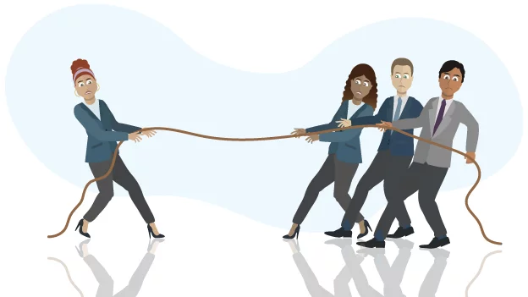
Resistance to Change

Slide 22
Why People Resist Change
Three categories
substance of the change
process the change is implemented
uncertainty that the change can generate

Slide 23
Typical Active and Passive Resistance to Change Behaviors
Palmer, I. (2021). Managing Organizational Change: A Multiple Perspectives Approach (4th ed.). McGraw-Hill Higher Education (US). https://bookshelf.vitalsource.com/books/9781264071579

Slide 24
Ways Resistance can be used Productively
Encourage dialogue.
Clarify the purpose.
Consider new possibilities.
Listen to the voices.
Deal with the past.

Slide 25
Implementing Change

Slide 26
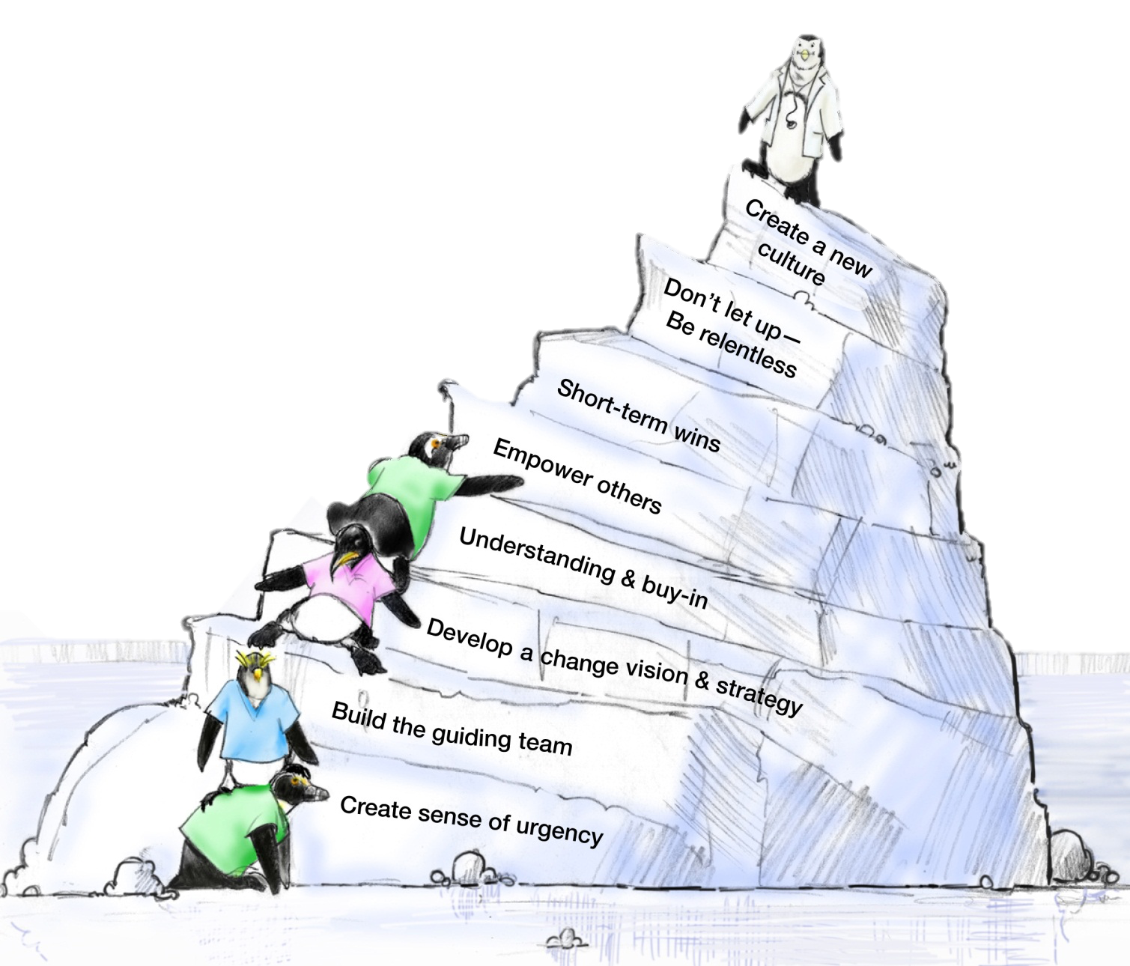
8 Steps of Change
John Kotter

Slide 27
Set the Stage and Create a Sense of Urgency
Get people’s attention!
Sell the need for change … describe the consequences of not changing
Immerse people in information about the change
Discuss ways to solve the problems people identify with the change
Empower people to solve the “problem”

Slide 28
Pull Together the Guiding Team
Choose
Choose key players, especially staff-level managers
Identify
Identify a Guiding Team that is multidisciplinary
Consider
Consider the credibility and integrity of change leaders
Choose
Choose proven leaders who can drive the change process
Strong position power, broad expertise, and high credibility
Ensure
Ensure the Guiding Team has both management and leadership skills
Management skills control the process
Leadership skills drive the change

Slide 29
Develop the Change Vision and Strategy
Senior Leadership is responsible for:
Establishing the definition of a “culture of safety” aligned with expectations, core values, and shared beliefs
Leading the process of:
Translating values into expected behaviors
Establishing trust and accountability
Communicating a commitment to shaping the culture

Slide 30
Communicate for Understanding and Buy-In
Provide supportive actions for fear, anger, and resistance
Encourage discussion, dissent, disagreement, debate—keep people talking
Tell people what you know―and what you don’t know
Acknowledge concerns, perceived losses, and anger
Model the expected behaviors
Value resisters
They clarify the problem and identify other problems that need to be solved first
Their tough questions can strengthen and improve the change
Their ideas may allow the leader to consider items that they might not have previously

Slide 31
Empower Others to Act
Provide direction
Allow others to find their own team-driven solutions
Encourage others to speak up and take risks
Share the information you know
Encourage teamwork and collaboration
Encourage personal reflection and learning
Train employees so they have the desired skills and attitudes
Track activities and progress
Set short-term goals

Slide 32
Produce Short-Term Wins
Show
Show visible success; further impetus for change
Provide
Provide positive feedback; recognize and reward contributions to wins
Further builds morale and motivation
Leverage
Leverage lessons learned to help plan next goal
Create
Create greater difficulty for resisters to block further change
Provide
Provide leadership with evidence of success
Build
Build momentum
Helps draw in neutral or reluctant supporters

Slide 33
Don’t Let Up
Acknowledge hard work
Celebrate successes and accomplishments
Reaffirm the vision
Bring people together toward the vision
Acknowledge what people have left behind
Develop long-term goals and plans
Provide tools and training to reinforce new behaviors
Reinforce and reward the new behaviors
Create systems and structures that reinforce new behaviors
Prepare people for the next change

Slide 34
Create a New Culture
Develop action steps for stabilizing, reinforcing, and sustaining the change:
Give people time to mourn their actual losses
Provide skill and knowledge training
Develop new reward systems
Recognize and celebrate accomplishments
Develop performance measures to continually monitor the results from the change and to identify opportunities for further improvements
Make adjustments to the change vision and strategy to reflect new learning and insights
Encourage people to be open to new challenges, forces, and pressures for the next change

Slide 35
Culture Change Comes Last, Not First!
Most alterations in norms and shared values come at the end of the transformation process
New approaches sink in after success is shown
Feedback and reinforcement are crucial to buy-in
Sometimes the only way to change culture is to change key people
Individuals in leadership positions need to be on board, or the old culture will reassert itself

Slide 36
The Key to Success for change is…..Developing an Organizational Culture

